Slide 1




Diplomado Xamarin
Day 5

Slide 2


Raul Montero
Megsoft Consulting, Inc.
Email: raul@megsoftconsulting.com

Slide 3

Agenda
Welcome!
Checklist
Technical Overview & Rules
Xamarin Challenge
Project Evaluations
Certificate
info@megsoftconsulting.com

Slide 4
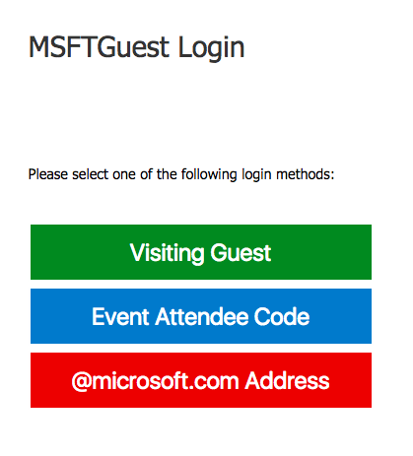
Wifi
SSID: MSFTGuest
Option: Event Attendee Code
Code: msevent48sm
info@megsoftconsulting.com

Slide 5
Before we begin - Checklist
MAC
PC
IDE
Xamarin Studio 6.2.1 or
Visual Studio for MAC Preview (latest)
Java
JDK 1.8.0_121
Android SDK
Android 6.0
iOS SDK
X Code 8.3
IDE
Visual Studio 2017 w/ Xamarin for Visual Studio or
Visual Studio 2015 w/ Xamarin for Visual Studio (4.3.0.795)
Java
JDK 1.8.0_121
Android SDK
Android 6.0
Mac?
If you plan on testing with iOS then you need network access to a Mac w/ X Code 8.3
info@megsoftconsulting.com

Slide 6
What is the Xamarin Challenge?
info@megsoftconsulting.com

Slide 7
Rules
Download the Starter Xamarin Project
Complete the Tasks
Upload your project to Github.com
You will be evaluated by one of the Technical Staff members
Upon completion you will receive a Certificate of Completion (digital)
info@megsoftconsulting.com

Slide 8
Materials
Repository:
https://github.com/RaulMonteroC/DiplomadoMSDay5
Requirements:
http://bit.ly/2sZ2lB4
info@megsoftconsulting.com

Slide 9


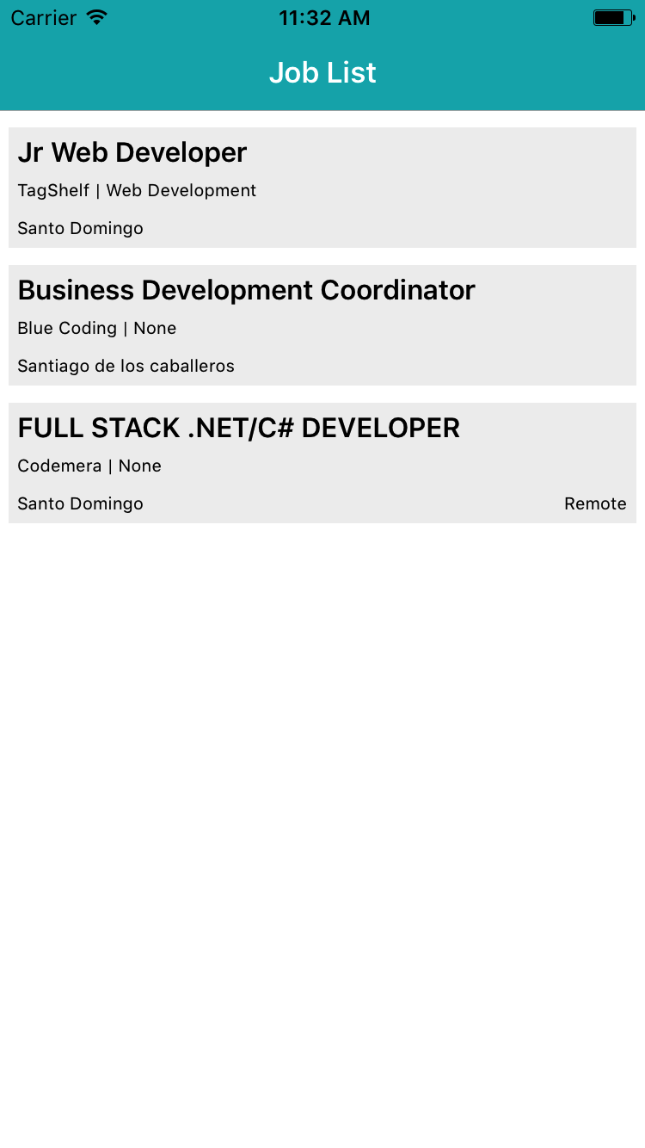
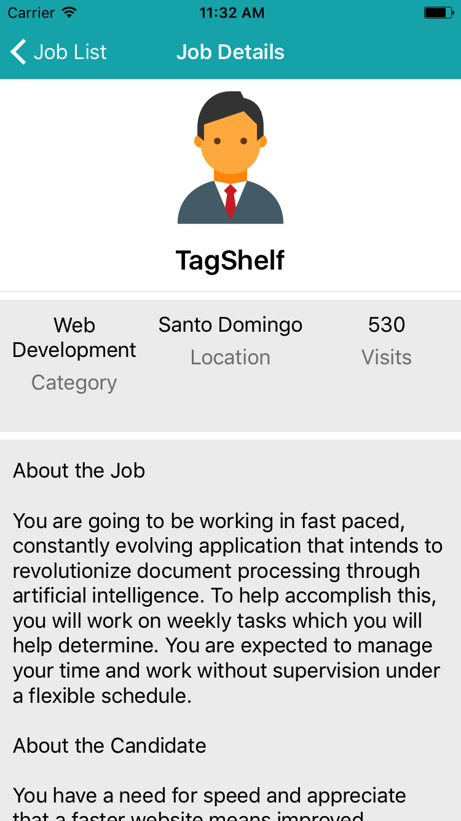
Code Challenge Tasks
Create a page that holds the job listing
Create a page with the job details
Configure prism (navigation and IoC)
Load data from azure service
Navigate from a job list item to the details page and load all the information

Slide 10
Feedback
http://bit.ly/FeedbackXam
info@megsoftconsulting.com

Slide 11


